Slide 1
Improving industrial performance
ProCS, Ltd.
Kráľovská ulica 8/824
927 01 Šaľa
Slovakia
May 2025

Slide 2
Concessions
Energy
Construction
Part of VINCI Energies
VINCI Autoroutes
VINCI Airports
VINCI Stadium
Other concessions
Infrastructure
Industry
Specialty Networks Division
Major Projects Division
Europe & Africa Division
United Kingdom Division
Americas & Oceania Division
Road Division France
Building Division France
Civil Engineering Division France
Networks Division France
Building Solutions
ICT
Notes:
Operating under VINCI, Actemium is the VINCI Energies’ brand dedicated to industrial processes. ​
VINCI Energies: €13,7 Billion TO; 83,800 employees; 1,800 BU’s; 55 countries
VINCI is a global player in concessions and contracting​ -
A robust worldwide leader present in over 110 countries with € 43.2 Billion revenue in 2020 & 218,000 employees​.
Concessions: €5.8 Billion revenue in 2020
The Contracting business that weighs €36.9 Billion overall turnover in 2020, covers 3 activities; including energy under VINCI Energies​.

Slide 3
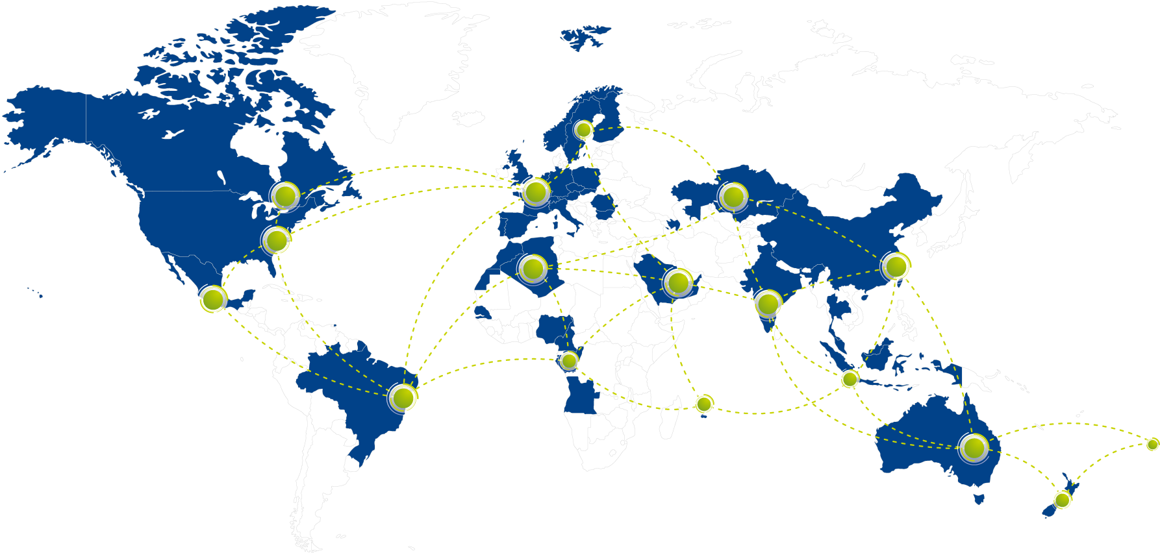
A powerful worldwide network
40
Countries
440
Business units
25,000
Employees
4€ BN
Notes:
Our powerful network consists of 22,000 employees, which enables us to share expertise & knowledge to best support our customers. Actemium covers 42 countries worldwide, with 400 Business Units.

Slide 4
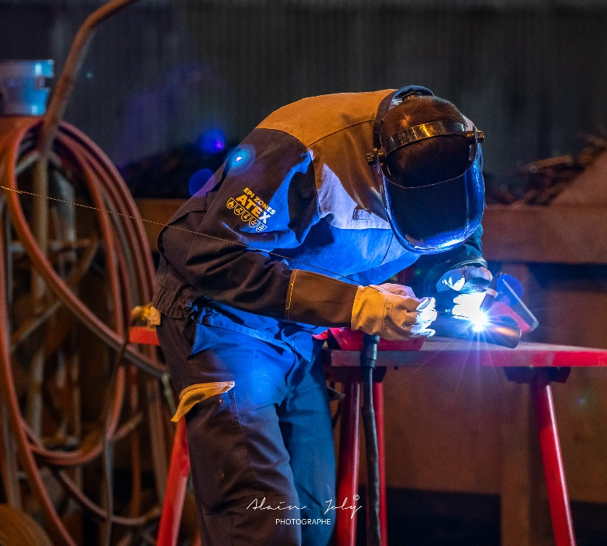
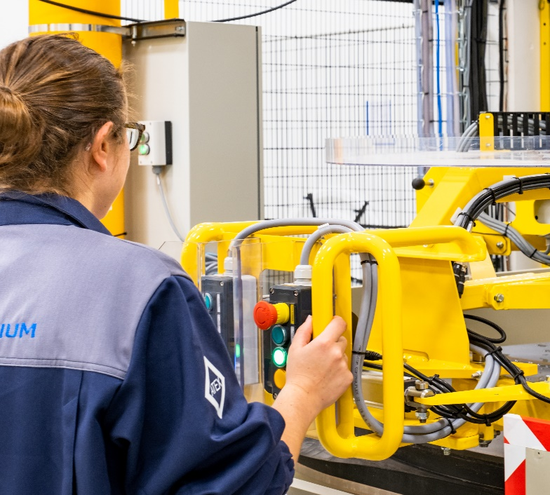
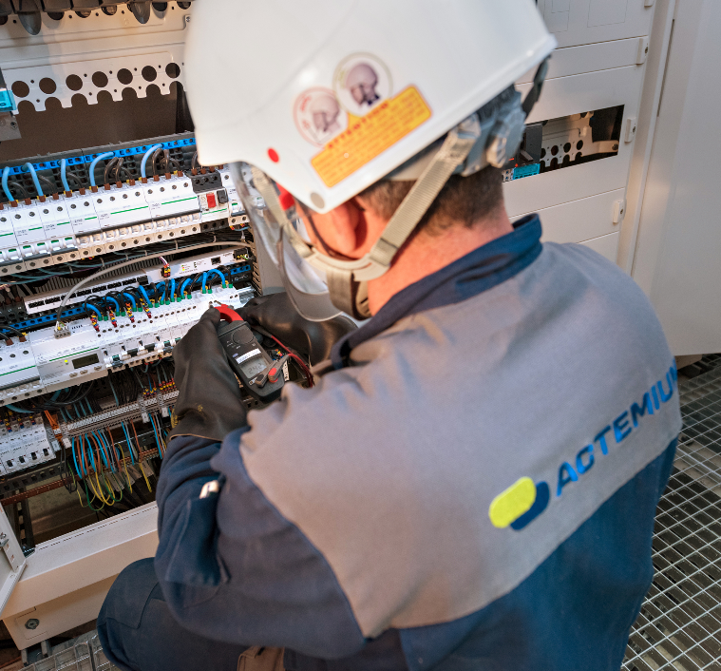
Accelerating your industrial performance for a better world
100 % dedicated to the industrial process improvement, The Actemium network enables a customized approach, presenting multi-technical, multi-site and multi-country solutions. Operating throughout the entire industrial life cycle, from design up to and including maintenance.
Vision &
missions
Notes:
Actemium’s vision ‘Accelerating your industrial performance for a better world’ is inspired by 3 strategic factors:
Economic & technical – Driven by value creation to continuously improve industrial performance of the customers’ factories.
Social – Next to safety and health excellence, to attract and retain talents specialized in industry is key.
Environmental – Become an even more environmentally responsible brand, by having green considerations in the full industrial life cycle (eg. re-use of energy, re-use of products, re-use of technological bricks, second life, alternative low-carbon solutions,…) and transform towards an eco-efficient model.

Slide 5
ACTEMIUM Slovakia
ProCS, Ltd. – the company history
1992 – establishment of ProCS, Ltd.
2007 – ProCS, Ltd. has become a member of VINCI Energies group
2015 – ProCS, Ltd. presents itself under the ACTEMIUM brand

Slide 6
The company activities
Industrial automation
Service & Maintenance
Assembly & Installation of electrical cabinets
Analytics
MES systems
Functional safety
Cyber security
Vibrodiagnostics
DESIGN
BUILD
MAINTAIN

Slide 7
Industrial automation
Engineering
Instrumentation and control design documentation processing
EPS, GDS project documentation processing
Electrical engineering including lightning, grounding and lighting
Software engineering
Control systems specification
Process automation
Field instrumentation
Installation
Consulting services
Analyzing processes
Electrical installation work, including installation and assembly of measuring, control and automation technology as well as electrical equipment, computer and optical networks

Slide 8
Industrial automation
Application software for DCS, ESDS, PLC, SCADA, ...
Continuous Chemical & Petrochemical process
Batch process
Safety Applications
Monitoring
Control & Safety Narratives
HMI Design
C&E Diagrams
Design of PID controllers, sequencies, .......
Alarms, Reports
Best practices
Safety application
FAT, SAT
Experiences

Slide 9
Industrial automation
On-site installations
Measuring and control instrumentation, including Analyzers
Different types of automation systems
WAN and LAN optical fibres or metallic communication systems
Electrical distributions, motor control, lightning, grounding and lighting systems
Testing and commissioning
Loop checks
Equipment functional testing
Acceptance tests (FAT, SAT)
Integration tests
In-process + Output inspections
as well as electrical cabinets inspection
Qualified and certified team

Slide 10
Service & maintenance
Warranty service, Post-warranty service based on the service level agreement
Automation systems preventive and complex maintenance
Emergency service
Repair of components or whole devices
Calibration of different measurement and control instrumentation (thermometers, pressure gauges, flowmeters, convertors etc.)
Administration of customer´s instrumentation and automations systems database
Changes in application software
Flexibility
Availability 24/7

Slide 11
Assembly & Installation of electrical cabinets
According to customer’s requirements, in accordance with the required technical standards
System cabinets for various control systems
Marshalling cabinets
Special LAN and WAN cabinets for industrial data communications on the basis of both optical and electrical networks
Low voltage switchgears with nominal voltage up to 1000 Volt and nominal current up to 4000 Amps:
Distribution
Motor Control (MCC)
Light distribution
From design to installation

Slide 12
Analytical systems
Design, build and installation
Design, engineering and installation from one place, including sampling systems and shelters
Long time experiences with different analyzers
Process control analyzers
Quality control analyzers
AMS analyzer systems for gas, liquid and solid particles
Design and installation of sampling systems
Supply of cabinets and shelters
Upgrade of existing analyzer systems
Solutions for explosive and hazardous areas
Solutions for several industry segments
All in one place

Slide 13
MES systems
SMART platform
ProCS has developed its own MES system with the following specifications
It is a system based on the standard application platforms extended by new functional modules developed by ProCS which are tailor-made to the specific customer needs and requirements
It is an open system communicating with the operators level through different standardized communication protocols (OPC, Modbus and DLMS)
Different alarm messages and protocols can be sent to the users via E-mail communication
It enables exporting of the data into different formats (MS Excel, PDF, …)
Innovative practices
Increasing productivity
Standard products
Wonderware products
Yokogawa Exaquantum

Slide 14
Functional safety
Increase the availability and reliability of operations, risk reduction and compliance with applicable regulations, transparency of security systems
Functional safety engineers of ProCS, certified by TÜV Rheinland, design safety related systems in compliance with the EN 61508 / EN 61511 standards
On May 2020 was issued a Declaration of Systematic Capability, proving the conformity of the established FSM system with the standards IEC61508 and IEC615111 (Systematic Capability SC3)
The company is authorized under Act No. 128/2015 on the:
Risk assessment
Elaboration and updating of the Safety report
Elaboration and updating of the Emergency plan
Consulting and advisory services
Safely & reliably

Slide 15
Cyber security
Effective protection against unauthorized access (location, account protection, encrypted communication, ...)
Access to the system allowing user authentication, strong passwords, access level setting, ...
Access and selected states monitoring
Networks separation (Segregation and Segmentation)
Systems and services hardening
Rules for handling portable media
Transparency of control systems throughout the whole life cycle
Risk reduction and compliance with applicable legislation
Control system design in accordance with best practices

Slide 16
Vibrodiagnostics
Providing timely information about the status of the monitored machine reduces maintenance costs
Developing a concept of machine diagnostic monitoring system
Engineering and design work – I/O, server, network infrastructure, protection
Installation of instruments and system itself
Setting up, testing, issuing protocols
Secure data transfer to higher-level networks
Knowledge of Brüel & Kjær, GE, Emerson monitoring systems
Analysis of measured data
Predictive maintenance
Design of vibration measurement systems

Slide 17
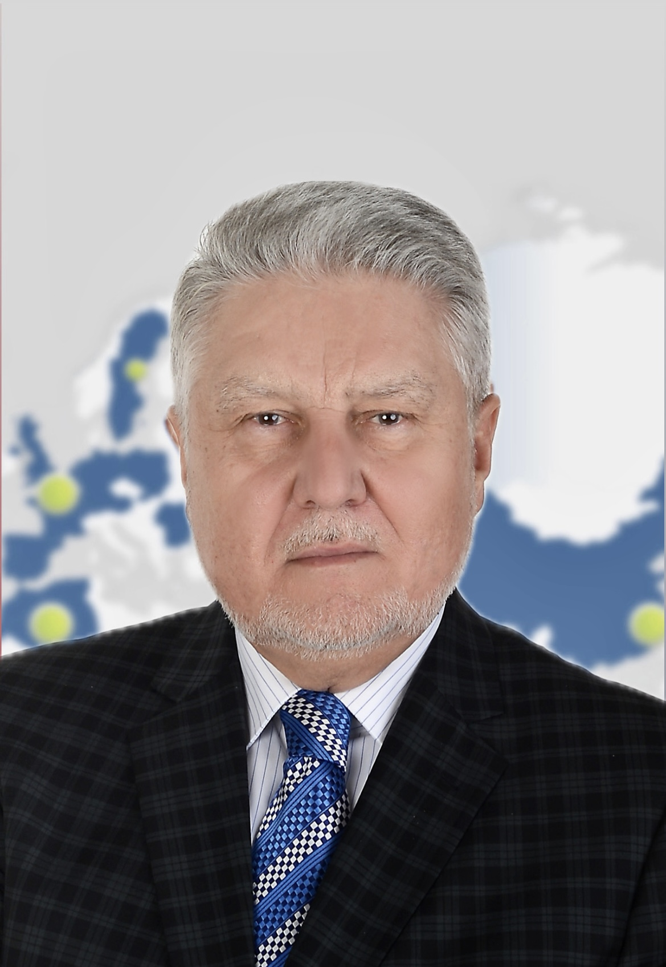
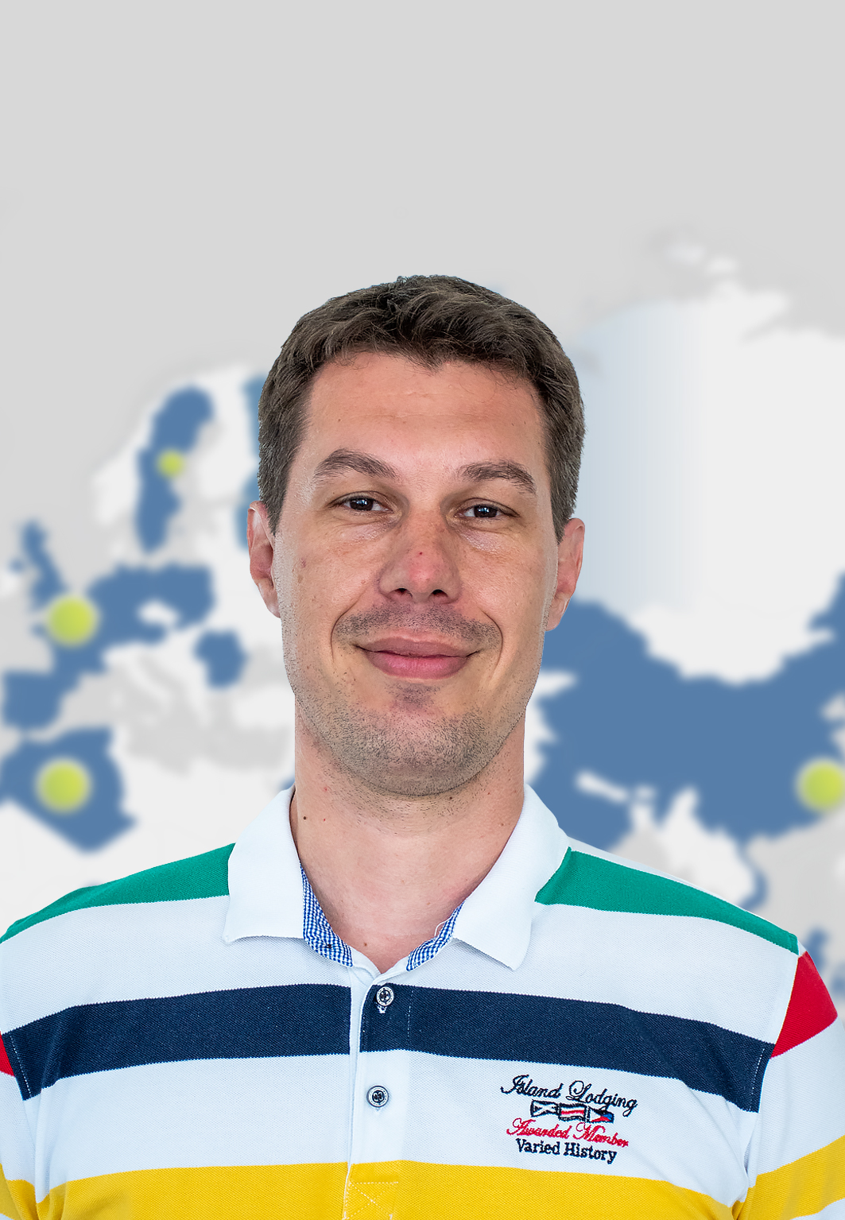
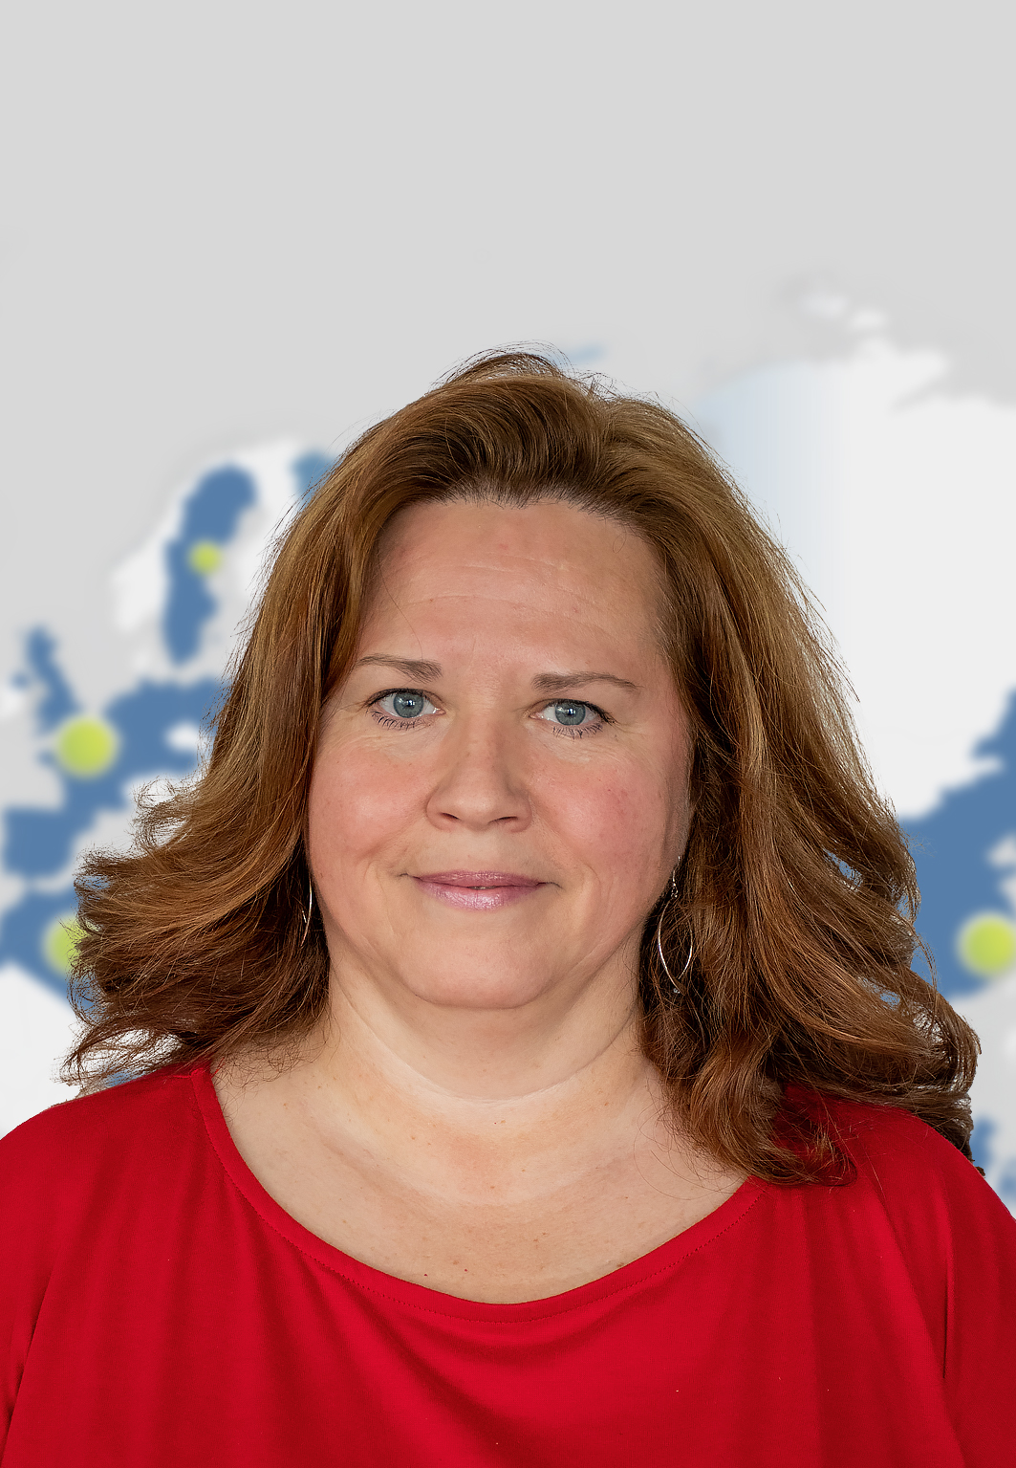
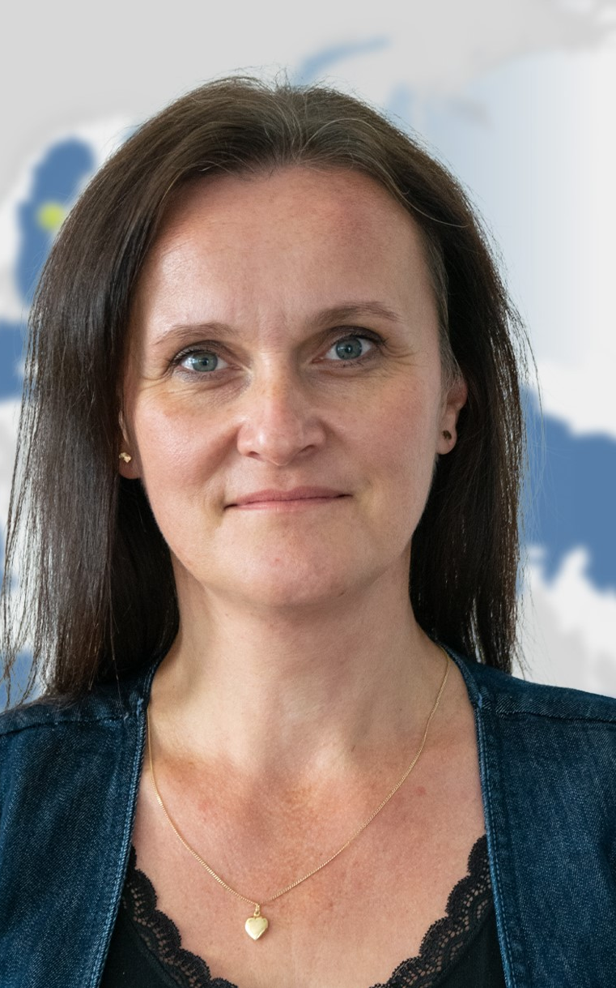
ProCS, Ltd. the company management
Ing. Štefan Bartošovič
Business Unit Manager
Ing. Jaroslav Sucháň
SALES
Ing. Jozef Szikora
DELIVERY
Ing. Miloš Pinka
ENGINEERING
Ing. Ivan Balogh
SERVICE
Ing. Jozef Szikora
(temporarily authorized)
PB & INSTALL
Emília Valábeková
(temporarily authorized)
FINANCE
Bc. Zuzana Kőrösiová
HRM

Slide 18
Human resources – special trainings
Control systems
PCS7 / SIEMENS
CENTUM / YOKOGAWA
DELTA V / EMERSON
VALMET DNA / VALMET
CITEC / SCHNEIDER
Programmable logical controllers
SIMATIC / SIEMENS
HIMATRIX / HIMA
NETCON, MICRONET, W505 / WOODWARD
PROSAFE / YOKOGAWA
CONTROLLOGIC / ROCKWELL AUTOMATION SERVICES
TRICON SYSTEM / INVENSYS
Regular training

Slide 19
Human resources – special trainings
Vibration monitoring systems
VC 8000 / BRÜEL & KJÆR
BN3500, SYSTEM 1 / BENTLEY NEVADA
AMS 6500 ATG / EMERSON
SCADA systems
INTOUCH / WONDERWARE
WINCC / SIEMENS
Information systems
MS SQL SERVER / MICROSOFT
APPLICATION SERVER / WONDERWARE
HISTORIAN / WONDERWARE
EXAQUANTUM / YOKOGAWA
Knowledge of systems

Slide 20
Human resources – special trainings
Implementation of design
SWITCHBOARDS - RITTAL, OEZ, ABB, SCHNEIDER, SCHRACK
PRODUCTS FOR SWITCHBOARDS - OEZ, SCHNEIDER, ABB, SCHRACK
CONTROLL SYSTEMS - YOKOGAWA, SIEMENS, B+R, B&K​
GDS - MSA A GM
EPS – SIEMENS
FREQUENCY CONVERTERS - ABB, SIEMENS, VONSCH, VACON, DANFOSS..​
LIGHTNING PROTECTION AND EARTHING - DEHN, SALTEK​
COOLING ISSUES AND EMC
Wide knowledge of products

Slide 21
Human resources – special engineering tools
CAE (Computer Aided Engineering) tools
ENGINEERING BASE / AUCOTEC
EXPERIENCE WITH OTHER SYSTEMS- RUPLAN, COMOS-PT, ELCAD, INTOOLS
CAD (Computer Aided Design) tools
AUTOCAD LT / AUTODESK
Engineering calculations tools
CONVAL / F.I.R.S.T.
EXSILENTIA / EXIDA
RISK TOOL / DEHN​
E-DESIGN / ABB​
SICHR / OEZ​
ECODIAL / SCHNEIDER​
DIALUX / DIAL
Special software tools

Slide 22
ProCS – integrated management system
Integrated management system has ProCS certified by SGS certification company
Quality management system according to the international standard ISO 9001:2015 requirements
Environmental management system according to the international standard ISO14 001:2015 requirements
Safety at work management system according to the international standard ISO 45 001:2018 requirements
Certified quality

Slide 23
System SCC (Safety Certificate for Contractors
SCC system has been established in the frame of ProCS which is focused on vendor´s qualification in the field of health and safety.
This system is closely linked to the Integrated management system (IMS) of ProCS and represents a special superstructure over it.
SCC system of ProCS has been certified by TUV SUD Slovakia and the system itself has been based upon german document called Normatives SCC-Regelwerk I Version 2011.
SCC certificate is valid until 12/2025.
Guaranteed safety

Slide 24
ProCS - certificates
Professional certificates
FS Engineer (TÜV Rheinland) – functional safety certified engineer
Declaration of Systematic Capability, proving the conformity of the established FSM system with the standards IEC61508 and IEC615111 (Systematic Capability SC3)
Authorizations
Authorized civil engineer
On-site supervision
On-site safety work coordinator
Major Industrial Accidents and Protection Expert
Guaranteed safety

Slide 25
ProCS - certificates
Authorizations
Mining activities, explosives and the State mining administration
Authorization according to § 17 of Act no. 513/2009 on tracks for carrying out specified activities
Contractors
Schneider Electric
Siemens
Regular training

Slide 26
Financial indicators
Turnover generated from core business activities
 | 2021 |  | 2022 |  | 2023
Turnover (in k€) | 8 064 |  | 8 854 |  | 7 632
 | kEUR | % | kEUR | % | kEUR | %
Sales of services | 5 645 | 70 % | 6 640 | 75 % | 5 648 | 74 %
Sales of hardware | 2 419 | 30 % | 2 214 | 25 % | 1 984 | 26 %
Turnover regional breakdown
 | 2021 |  | 2022 |  | 2023
Turnover (in k€) | 8 064 |  | 8 854 |  | 7 632
 | kEUR | % | kEUR | % | kEUR | %
Domestic sales | 6 854 | 85 % | 7 752 | 88 % | 6 674 | 87 %
Export sales | 1 210 | 15 % | 1 102 | 12 % | 958 | 13 %

Slide 27
SLOVAKIA
ProCS, Ltd. – scope of activities
Chemicals
Energy
O&G
Nuclear
Pulp & Paper
EXPORT
O&G
Logistics
Pulp & Paper
Automotive
Notes:
Actemium centers its approach by being customer-oriented. This approach is built on a strong foundation, starting with:
Quality-driven solutions and services based on reliability, productivity, flexibility and sustainability.
Which is supported by:
· A decentralized organization – the ability to react with agility to new industry expectations & customer needs.
· Being a global player – offering customized multi-technical, multi-site and multi-country services.
· A segmented approach – deep specific process knowledge leads to a bigger value that BU’s bring towards their customers.
Ultimately building Actemium’s purpose, improving industrial performance.

Slide 28
ProCS, Ltd. – major partners
Germany
Sweden
The Netherlands
Notes:
Actemium centers its approach by being customer-oriented. This approach is built on a strong foundation, starting with:
Quality-driven solutions and services based on reliability, productivity, flexibility and sustainability.
Which is supported by:
· A decentralized organization – the ability to react with agility to new industry expectations & customer needs.
· Being a global player – offering customized multi-technical, multi-site and multi-country services.
· A segmented approach – deep specific process knowledge leads to a bigger value that BU’s bring towards their customers.
Ultimately building Actemium’s purpose, improving industrial performance.

Slide 29
THANK YOU FOR YOUR ATTENTION
ProCS, Ltd.
Kráľovská ulica 8/824
927 01 Šaľa
SLOVAKIA
Tel.: +421 31 7731111
info@actemium.sk
www.actemium.sk
linkedin.com/company/actemium-slovakia

